Slide 1

APAN 5210
AI AGENT
Kibaek Kim (kk3789)
Shuyi Wang (sw3970)
Shuteng Xie (sx2405)
Angelina Ying (ky2604)
Jing Xiao (jx2617)
Sze Ning Tan (st3730)

Slide 2

OVERVIEW
Our AI agent is designed specifically for data analysis projects. It automatically reads the data, selects suitable analytical models, generates Python code, interprets the results, and produces a complete, professional report — all through a fully autonomous and reflective workflow with multi-agents and multi-LLM models.
Built with scalability, our multi-agent application is deployed on the Streamlit framework and supports integration with local LLM models, ensuring flexible, efficient, and cost-effective deployment across different environments.

Slide 3
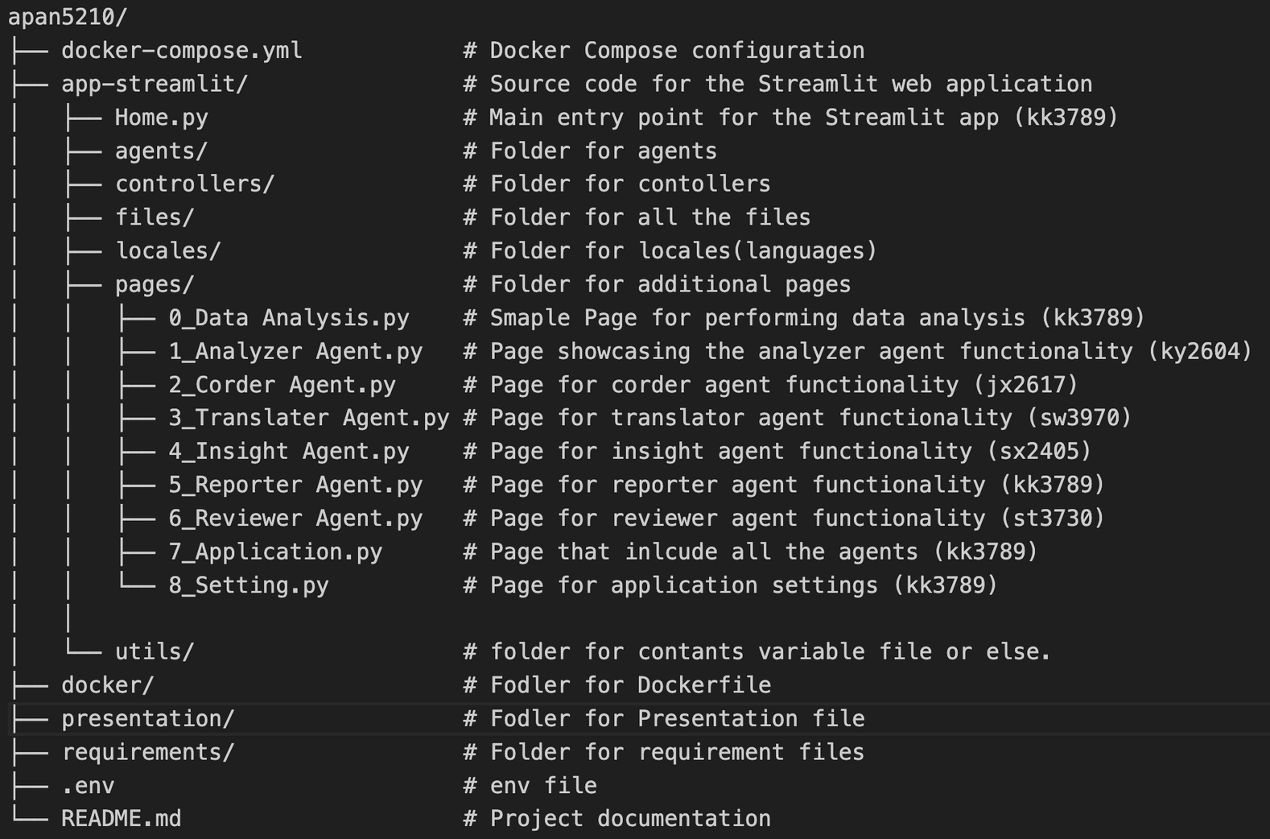
Docker Container and Folder Structure
https://github.com/hyper07/apan5210

Slide 4

Workflow Diagram
Recommend Models
Generate Codes
Analyze Model Outputs
Analyzer
(deepseek)
Code
(qwen2.5-coder:3b)
Insight
(phi3)
Translate
(phi4-mini)
Translate Text
Review
(llama3.2:1b)
Report
(exaone3.5:2.4b)
Evaluate Variables and Final PDF
Generate Reports (PDF)

Slide 5
Analyzer
User will upload a file(csv/excel), and their analytic goal as input, this agent will analyze the structure of the content, and will learn what are some model to meet the analytic goal.
The output will be text, it will recommend what model is the best for the analytic goal, also exolaining the model.
Recommend Models
CSV&Goal
Analyzer
Recommended
ML Model(s)

Slide 6
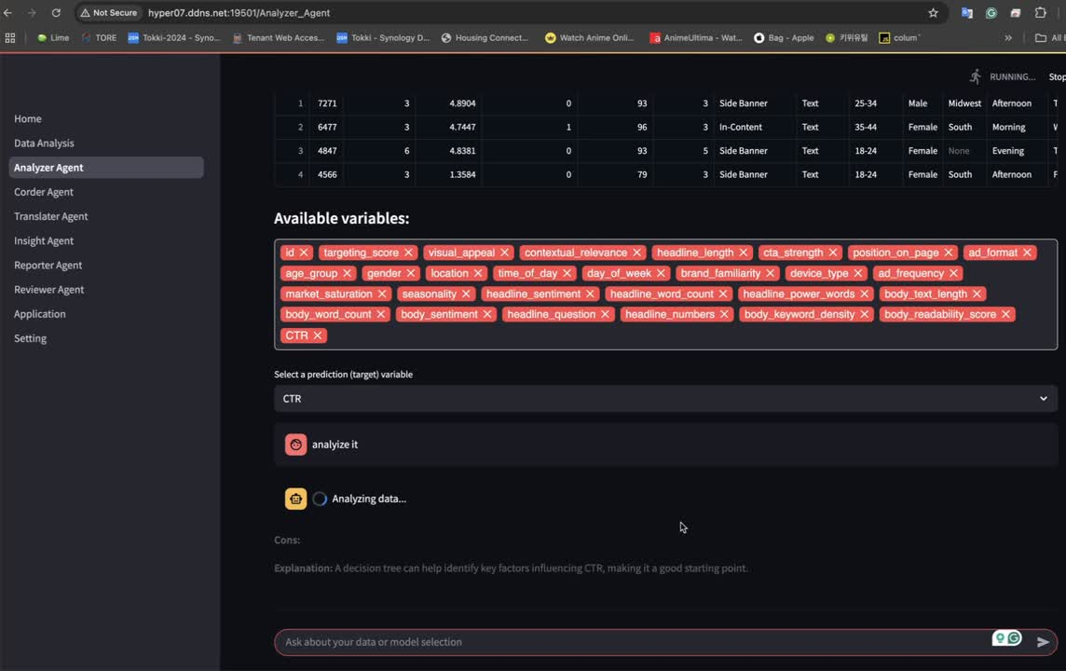

Slide 7
Code
This agent receives the results of the model recommendation from the previous agent (Analyzer), which sends the model name and analysis goals to the language model.
The model returns ready-to-run Python code containing the complete process of model training and evaluation, and the output is in text format with executable code blocks.

Slide 8
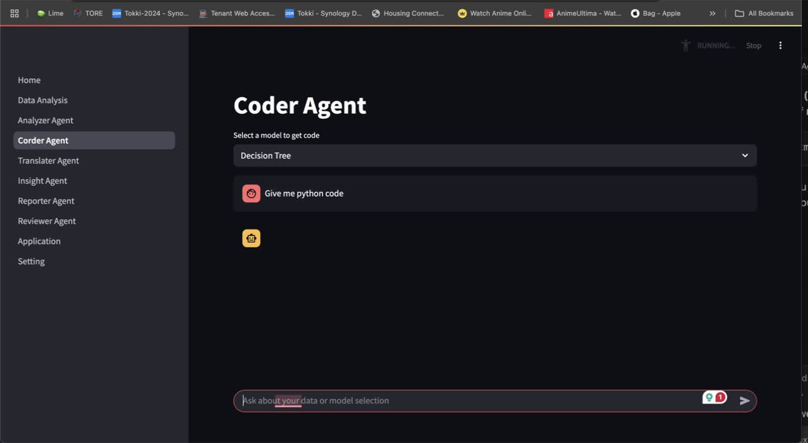

Slide 9
Insight
This agent executes the code and evaluates the results produced by the Python code, considering both the recommended model and the characteristics of the input data.
Based on the outcomes, it generates meaningful insights and provides evidence-based suggestions to support data-driven decision-making.

Slide 10
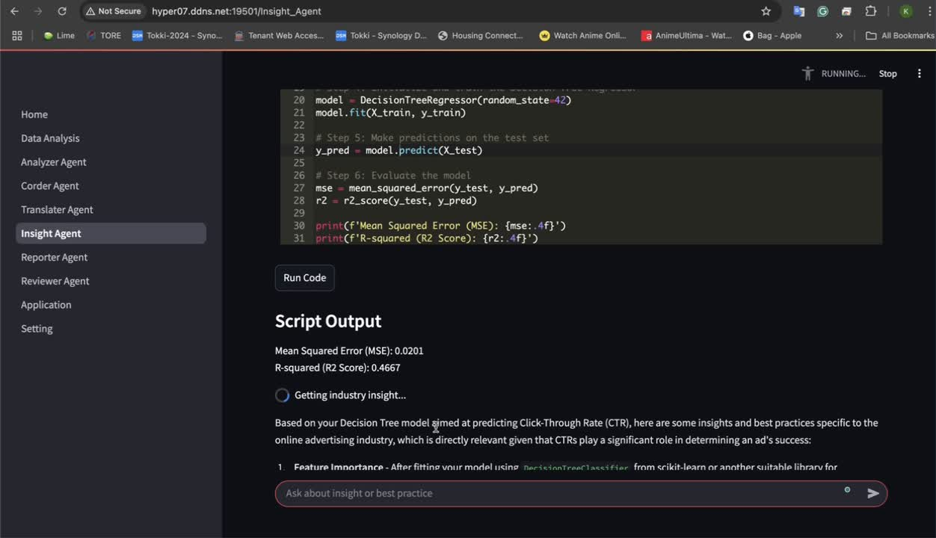

Slide 11
Report
This agent receives output from Insight and Translate, including analysis results and translated text.
It consolidates the content into clearly structured and formatted reports that summarize analytical findings, model performance, and key insights by GenAI.
Save to PDF and allow to download it.

Slide 12
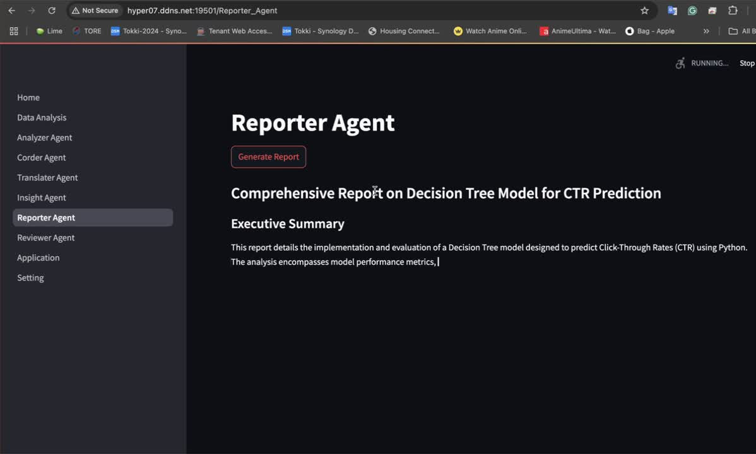

Slide 13
Review
This agent takes the combined outputs of the previous Agents (1-5), feeds those into LLM (via Ollama) to Polish & Refine
Improve clarity & logical flow in the wordings
Standardize terminology for consistency
Adds smooth transitions
Adds appropriate structures to the output
Lastly, uses Streamlit to render a polished narrative in a simple UI

Slide 14
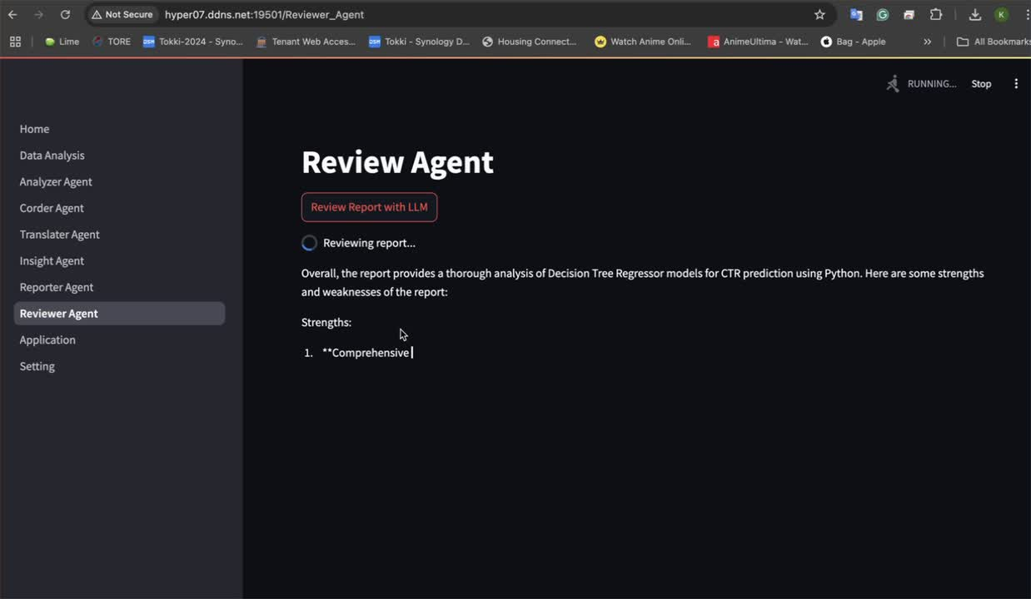

Slide 15
Translate
Translate the text into target language(s), based on the context and the input from the Insight, report, review agent.
The translated output would be used to generate reports in multiple languages. Thus, the translate agent plays an important role in ensuring clarity and maintain consistency.

Slide 16
Future Improvement
Small LLM models showed significant performance gaps and failed to deliver the desired quality. To address this, we opted for a slightly larger model combined with Retrieval-Augmented Generation (RAG) to enable local, continuous training.
In the Insights section, LLM-based insights were underwhelming. Integrating an internet search module, similar to Perplexity, improved the ability to generate relevant and updated insights.
The Python code generated by GenAI varied in quality, often leading to runtime errors. By refining prompts, we improved code quality, and introducing an Error Handling Agent allowed automatic code correction for error resolution.
Converting reports to PDF posed challenges in achieving clean, professional styling. Through prompt tuning, we enhanced the output quality for better-formatted PDF reports.

Slide 17
Conclusion
This system demonstrates a complete automated data analysis process, from model selection and code generation to result interpretation and report writing.
By assigning tasks to multiple dedicated agents and combining the capabilities of large language models, the system demonstrates a high degree of modularity, flexibility and intelligence, with good potential for practical applications.

Slide 18
THANK YOU

